Slide 1

PrivKV: Local Differential Privacy for Key-Value Structured Data
CSC 6223
Wasfi Momen
11/16/18

Slide 2
Overview
Background/Related Work
PrivKV goals
Basic Concepts
Key-Value Protocols
PrivKV
Experiments

Slide 3
Background/Related Work
No work done to protect privacy in key-valued databases. Keys and values are separated before perturbed.
Most algorithms use separate algorithms for each type of numerical, categorical, or set-valued data.

Slide 4
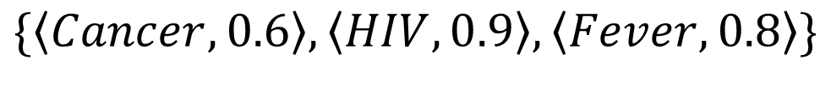
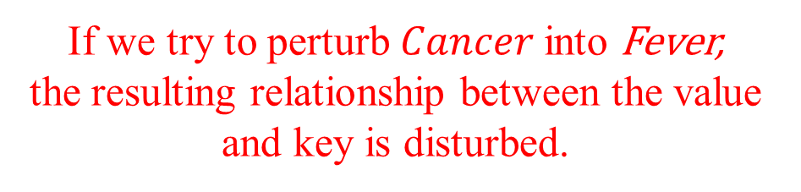
Background/Related Work
No work done to protect privacy in key-valued databases. Keys and values are separated before perturbed.
Most algorithms use separate algorithms for each type of numerical, categorical, or set-valued data.
$$\{\left\langle Cancer, 0.6\right\rangle , \left\langle HIV, 0.9\right\rangle ,\left\langle Fever, 0.8\right\rangle \}$$
If we try to perturb $Cancer$into Fever,
the resulting relationship between the value and key is disturbed.

Slide 5
PrivKV goals
Provide a “privacy-preserving key-value data collection for frequency and mean estimation in local setting” with an untrusted data collector/maintainer/publisher.
Use a lot of prior research to provide a new protocol.
[5] R. Bassily and A. Smith. Local, private, efficient protocols for succinct histograms. In STOC, pages 127–135. ACM, 2015.
[6] R. Bassily, U. Stemmer, A. G. Thakurta, et al. Practical locally private heavy hitters. In NIPS, pages 2285–2293, 2017.
[31] T. T. Nguyˆen, X. Xiao, Y. Yang, S. C. Hui, H. Shin, and J. Shin. Collecting and analyzing data from smart device users with local differential privacy. arXiv:1606.05053, 2016
[41] Y. Wang, X. Wu, and D. Hu. Using randomized response for differential privacy preserving data collection. In EDBT/ICDT Workshops, 2016
[42] S. L. Warner. Randomized response: A survey technique for eliminating evasive answer bias. Journal of the American Statistical Association ,60(309):63–69, 1965
…and many more
Also provide options for iterative optimization (PrivKVM) and for iterative cost analysis (PrivKVM⁺)

Slide 6
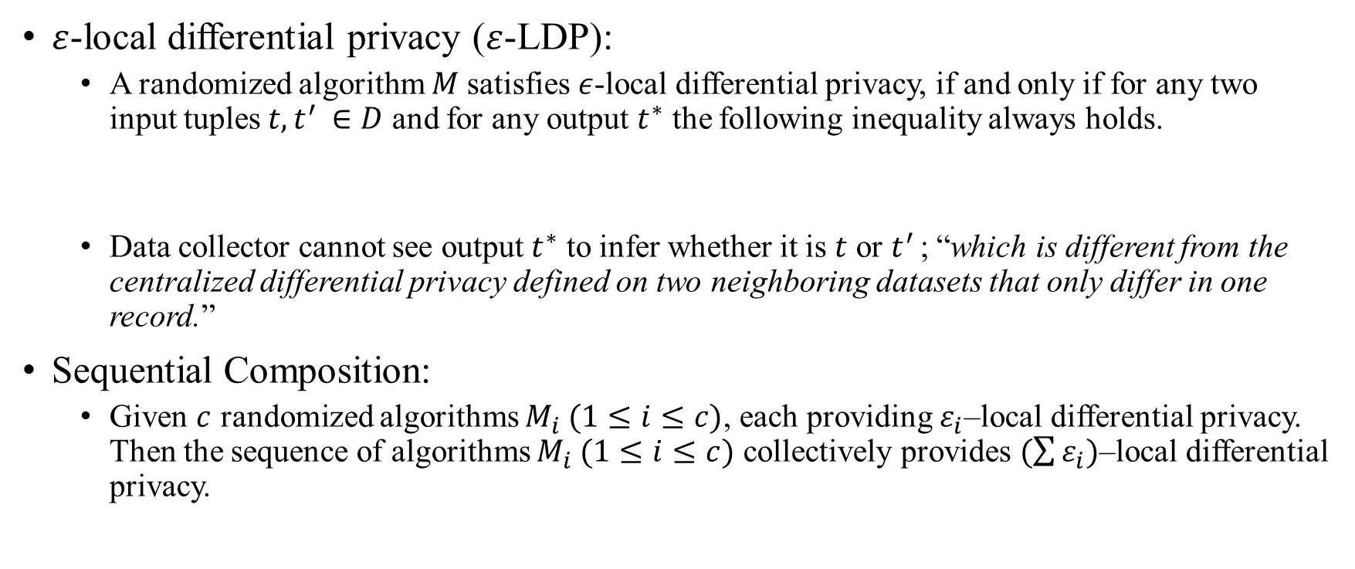
Basic Concepts
$ε$-local differential privacy ($ε$-LDP):
A randomized algorithm $M$satisfies $ε$-local differential privacy, if and only if for any two input tuples $t, t^{′ }∈D$ and for any output $t^{∗}$ the following inequality always holds.
Data collector cannot see output $t^{∗}$ to infer whether it is $t$ or $t^{′ }$; “which is different from the centralized differential privacy defined on two neighboring datasets that only differ in one record.”
Sequential Composition:
Given $c$ randomized algorithms $M_{i} (1≤i≤c)$, each providing $ε_{i}$–local differential privacy. Then the sequence of algorithms $M_{i} (1≤i≤c)$ collectively provides $(\sum{ε_{i})}$–local differential privacy.
$$\operatorname{Pr}\left[M\left(t\right)=t^{∗}\right]≤e^{ε}×\operatorname{Pr}\left[M\left(t^{′}\right)=t^{∗}\right]$$

Slide 7

Randomized Response
Ask responder to answer a question truthfully based on probability such that the answerer can retain plausible deniability.
Flip a coin, if tails then yes and if heads then answer yes/no truthfully.
Specifically, $EP= \frac{YA+p −1 }{2p −1 }$ with EP as the true proportion of answers out of YA yes answers. (note that p can’t be ½)
Example:
Actual Scenario Question (p=⅓)
2 cards: one with question, one with question conjugate
Probability ⅓ to answer question.
Probability ⅔ to answer conjugate.
So absolute yes and no cancel out. Yes minus no gives 3 times the actual answers.
100 responses, 20 yes, 80 no.
80 – 20 = 60, so 60%
Concept Understanding Question (p=½)
500 responses, probability ½ to answer.
So 250 answered the question and 250 didn’t.
479 Yes – 250 = 229/250 = .916 = 91.6%
21 No / 250 = .084 = 8.4 %
Notes:
YA = (p* EP) + (1-p)(1-EP)
NA = (1 – EP)p + EP(1-p)
NOTE: Important for actual scenario to be conjugate. If you answer True to one question, it will negate the other, therefore keeping the mean.
- Don’t get too caught up in the math, just know the basic concept.
- Important that responder answers truthfully.

Slide 8



Randomized Response
To modify RR for $ε$-local differential privacy, we change p probability to be:
And the data collector will need f “true” answers:
$$p= \frac{e^{ε}}{1+e^{ε}}$$
$$f^{′}= \frac{p −1+f}{2p −1 }$$

Slide 9
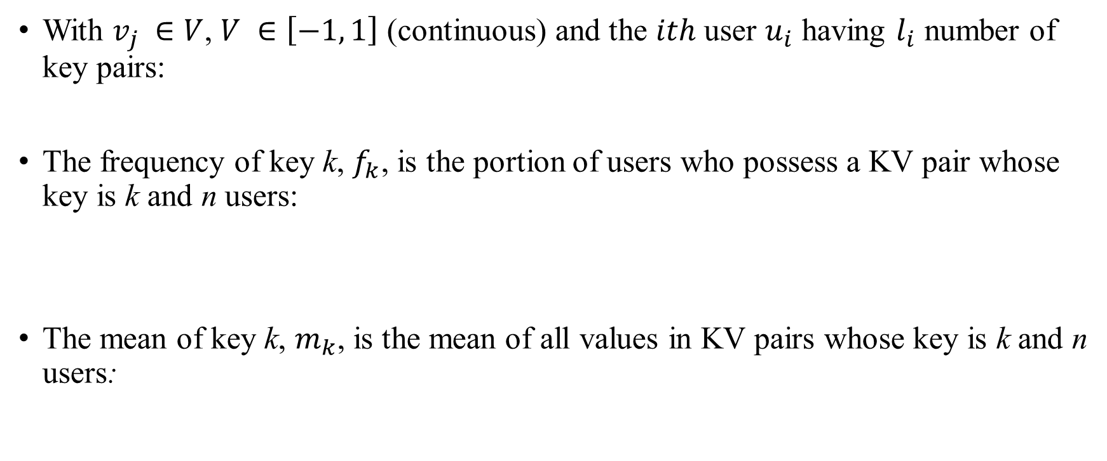


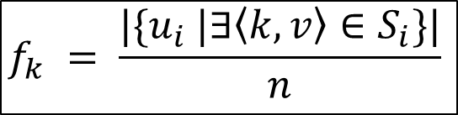
Definition of Key-Value Protocol
With $v_{j} ∈V$, $V ∈\left[−1, 1\right]$ (continuous) and the $ith$ user $u_{i}$ having $l_{i}$ number of key pairs:
The frequency of key k, $f_{k}$, is the portion of users who possess a KV pair whose key is k and n users:
The mean of key k, $m_{k}$, is the mean of all values in KV pairs whose key is k and n users:
$$S_{i}=\left\{\left\langle k_{j}, v_{j}\right\rangle \right| 1≤j≤l_{i}\}$$
$$f_{k} = \frac{|\{u_{i} |∃\left\langle k, v\right\rangle ∈S_{i}\}|}{n}$$
$$m_{k}= \frac{Σ_{i}Σ_{j:k_{j}=k_{ }^{v_{j}}}}{n ∗ f_{k} }$$
Notes:
- Si is the set of KV pairs that user ui has.
- Frequency is for each user they have a key in Si divided by n number of users.
- Mean is the sum of all values that are all the same k that are owned by users n.

Slide 10
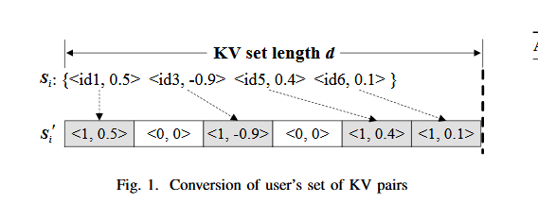
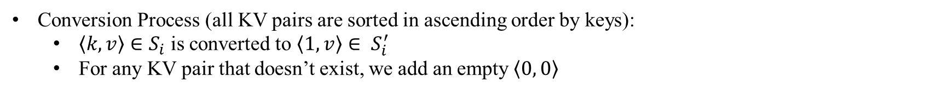
Flawed Key-Value Perturbation Protocol
Conversion Process (all KV pairs are sorted in ascending order by keys):
$\left\langle k, v\right\rangle ∈S_{i}$ is converted to $\left\langle 1, v\right\rangle ∈ S_{i}^{′}$
For any KV pair that doesn’t exist, we add an empty $\left\langle 0, 0\right\rangle$
Notes:
- NOTE: Be sure to point out the ids are sequential and sorted.
- For <0,0> you basically add a value that DNE. Like here there is a skip between .5 and -.9 for id1 and id3 so we add a single <0,0> pair.

Slide 11
Flawed Key-Value Perturbation Protocol
Now all keys are either 0 or 1 (binary). By a certain probability, we change flip the key to its opposite so that the data collector cannot predict a user has had a KV pair.
The values are changed as follows:
If key is 1, then don’t change value.
If key is 0, then don’t change value.
If key went from 1 to 0, then set value to 0 since key is empty and missing. (Mean estimation preserved)
If key went from 0 to 1, then randomly set key a value between [-1, 1] in the continuous domain.

Slide 12
Flawed Key-Value Perturbation Protocol
The last step introduces a flaw since a random value is assigned (0 to 1).
Data collector will be able to guess a true value given many values with high confidence.
Especially in the case that the true values deviate from the uniform randomness of [-1,1].
A uniform distribution also allows for a mean of 0–affecting the mean estimation for that key.
To fix, we perturb a value regardless whether it is real or assigned value in the conversion process.
Notes:
- NOTE: Last step isn’t shown in the picture.
- True values like if we see .4 or 1.2323 and then the next value after conversion is <1,.2> like hmmm that might be false.
- If all true value mean = 0 or true mean = perturbed mean and all uniform perturbed keys are 0 or perturbed keys = - true mean then 0 mean. Total info loss.

Slide 13
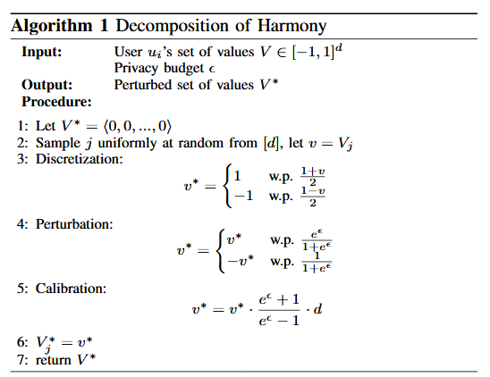
Proper Perturbation
Mainly relies on Harmony
[31] T. T. Nguyˆen, X. Xiao, Y. Yang, S. C. Hui, H. Shin, and J. Shin. Collecting and analyzing data from smart device users with local differential privacy. arXiv:1606.05053, 2016
Converts numerical values in KV pairs to binary and perturb with RR.
Values will be either -1 or 1 (discrete); d is the set of natural numbers {0, 1, 2…}
However, mean will be biased, so we will need to calculate the bias via a calibration which can be done by the data collector or data producer.
Notes:
- NOTE: Values will be only 1 or -1, no .9 or anything. Also, this does nothing to key k.
- “Each perturbed value in Harmony is simply scaled d times to counterbalance the effect of sampling, which may
also cause bias.”

Slide 14
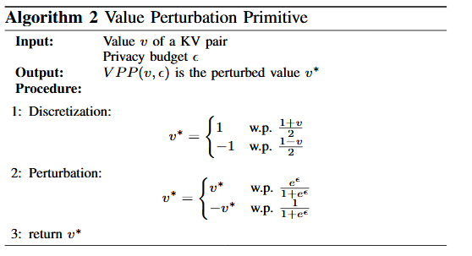
Value Perturbation Primitive
Notes:
NOTE: Calibration is moved to data collector side. Shown in complete PrivKV. Also, key k is not changed.
3 changes to calibration:
Moved to data collector.
Scaling by d is moved to complete PrivKV by summing the values of the sample keys to get the mean. (Complete PrivKV)
If N users have the same key, we can perturb values together data collector side. However, the mean estimation will maybe be biased, but will improve accuracy (especially with small privacy budget).

Slide 15
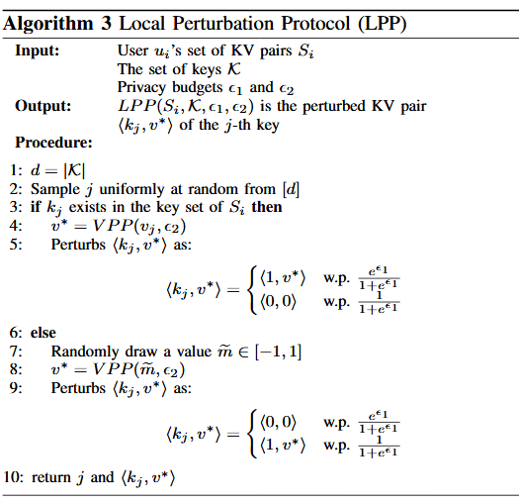
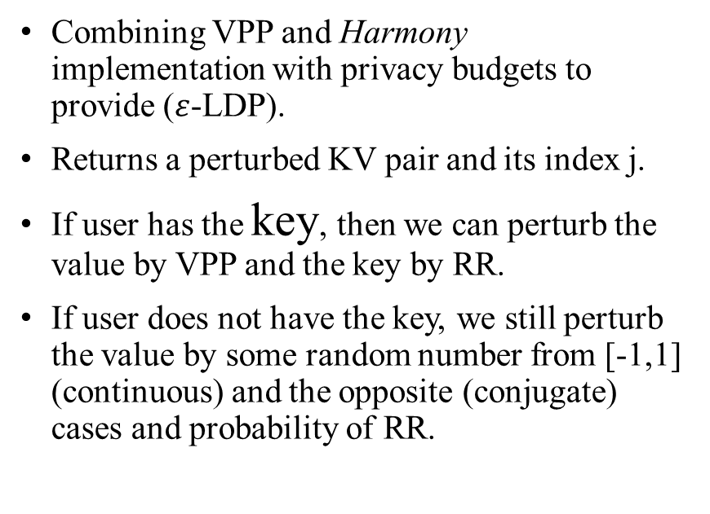
Local Pertubation Protocol
Combining VPP and Harmony implementation with privacy budgets to provide ($ε$-LDP).
Returns a perturbed KV pair and its index j.
If user has the key, then we can perturb the value by VPP and the key by RR.
If user does not have the key, we still perturb the value by some random number from [-1,1] (continuous) and the opposite (conjugate) cases and probability of RR.
Notes:
To reduce communication cost to O(1), Line 2 does random sample of keys to report to data collector.
<k,v> to (4)<k, v*> to (5)<1,v*> or <0,0> , remember doesn’t affect mean estimation because we calibrate the values
For the user DNE case, give the marijuana card example from the RR slide.
For the user DNE case, we retain key-value relationship (Cancer to Fever) since we just randomly get a value that has no meaning to a key that DNE.

Slide 16
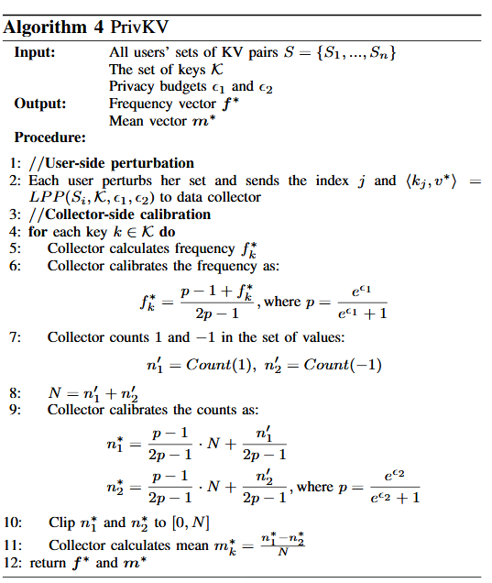
PrivKV
User computes LPP and sends the set of KV pairs, the set of keys, and two privacy budgets, one for the frequency and one for the mean.
All users send their values of LPP to the collector.
The calibration for mean estimation is done by counting every value across all users, which is either -1 or 1 based on probability p with the second privacy budget.

Slide 17
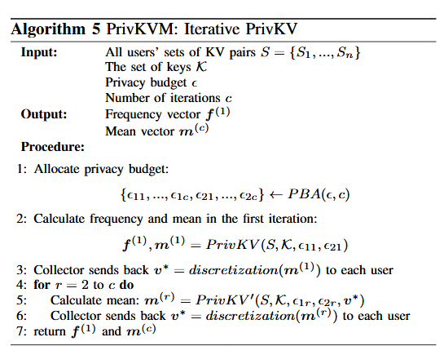
PrivKVM
Iterative, low-cost PrivKV
Lots more math to work on, proofs for both in the paper. Need PBA, privacy budget allocation and asks users for their own separate means based on computations.
Also have PrivKVM⁺ which adds another variable, communication cost, since we do have to go back and forth between users.

Slide 18
Experimental Evaluation
Two datasets tested:
TalkingData SDK mobile events. Key is event category and value is the number of events in the category. 32,473,067 events with 306 categories.
JData shopping records. Key is a single brand name and value is the number of times a user purchased from the brand. 442 brands and 105,180 users.
Combined PrivKVM with Harmony and RAPPOR to see effect of PrivKVM. Also tested in comparison to k-RR and SHist.

Slide 19
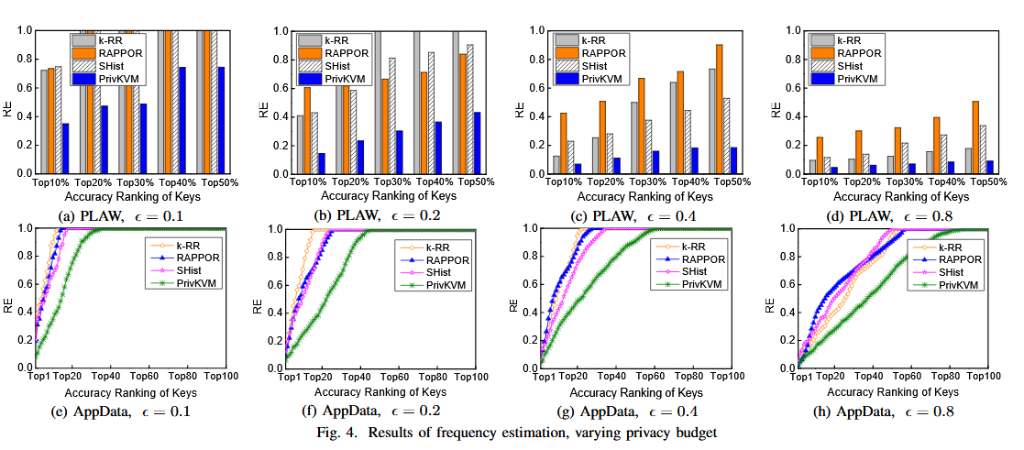

Slide 20
